Slide 1

INT219
FRONT END WEB DEVELOPER
Lecture #0
The kick start session

Slide 2
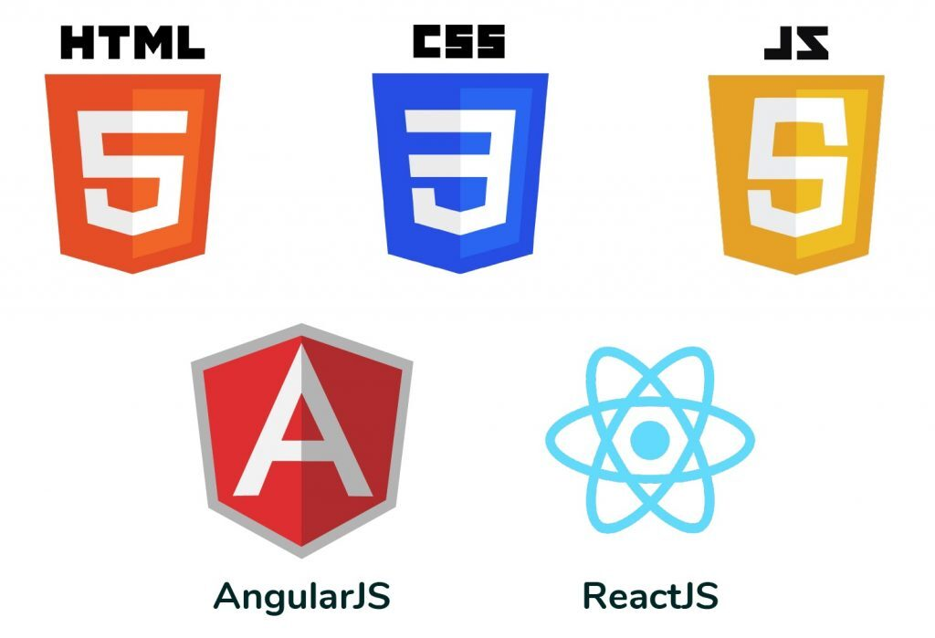
Course details
LTP – 2 0 2
Credit – 3

Slide 3
Course details
LTP – 2 0 2
Credit – 3

Slide 4
Assessment/Evaluation Scheme
Attendance: 5%
CA: 45%
ETP: 50%

Slide 5
Complete evaluation criteria for the course
CA Category: C010102
CA1: 30 marks- Code Based BYOD Test
To assess the students’ coding skills using HTML, CSS and Javascript with DOM for creating web pages. NOTE: The CA1 will be allocated in 4th Week and conducted in 5th Week.
CA2: 30 marks- Code Based BYOD Test
To assess the students’ coding skills using JSON, JQuery and Bootstrap and basic Angular framework. NOTE: The CA2 will be allocated in 11th Week and conducted in 12th Week.
CA3: 30 marks- Project (Skilled based CA)(Compulsory)
To assess the students’ logic building and programming skills. Students has to make a complete responsive website using angular framework. NOTE: The CA3 will be allocated in 4th Week and student will submit it in 12th Week.

Slide 6
Complete evaluation criteria for the course
CA3: Marks Enhancement using social media footprint
30 marks project will be taken.
EXAM Category: X6
ETP: 100 marks
Coding and viva, Evaluated by External Examiner

Slide 7

Revised Bloom’s Taxonomy

Slide 8
Course outcome
Through this course students should be able to:
CO1 : apply basic HTML elements, CSS properties and Bootstrap to create visually appealing web pages.
CO2 : use JavaScript variables, functions, and events to enhance user interactivity on web pages.
CO3 : develop interactive web forms and validate user input to enhance form handling.
CO4 : manipulate HTML elements, handle events, and create dynamic web content using JavaScript and DOM.
CO5 : employ jQuery for efficient element manipulation and work with JSON objects for seamless data exchange.
CO6 : develop dynamic web applications using Angular, and HTTP requests with forms, components, and directives.

Slide 9
Program Outcomes
PO1
Engineering knowledge: Apply the knowledge of mathematics, science, engineering fundamentals, and an engineering specialization to the solution of complex engineering problems.
PO2
Problem analysis::Identify, formulate, research literature, and analyze complex engineering problems reaching substantiated conclusions using first principles of mathematics, natural sciences, and engineering sciences.
PO3
Design/development of solutions::Design solutions for complex engineering problems and design system components or processes that meet the specified needs with appropriate consideration for the public health and safety, and the cultural, societal, and environmental considerations.
PO4
Conduct investigations of complex problems::Use research-based knowledge and research methods including design of experiments, analysis and interpretation of data, and synthesis of the information to provide valid conclusions.

Slide 10
Program Outcomes
PO5
Modern tool usage::Create, select, and apply appropriate techniques, resources, and modern engineering and IT tools including prediction and modeling to complex engineering activities with an understanding of the limitations.
PO6
The engineer and society::Apply reasoning informed by the contextual knowledge to assess societal, health, safety, legal and cultural issues and the consequent responsibilities relevant to the professional engineering practice.
PO7
Environment and sustainability::Understand the impact of the professional engineering solutions in societal and environmental contexts, and demonstrate the knowledge of, and need for sustainable development.
PO8
Ethics::Apply ethical principles and commit to professional ethics and responsibilities and norms of the engineering practice.
PO9
Individual and team work::Function effectively as an individual, and as a member or leader in diverse teams, and in multidisciplinary settings.

Slide 11
Program Outcomes
PO10
Communication::Communicate effectively on complex engineering activities with the engineering community and with society at large, such as, being able to comprehend and write effective reports and design documentation, make effective presentations, and give and receive clear instructions.
PO11
Project management and finance::Demonstrate knowledge and understanding of the engineering, management principles and apply the same to one’s own work, as a member or a leader in a team, manage projects efficiently in respective disciplines and multidisciplinary environments after consideration of economic and financial factors.
PO12
Life-long learning::Recognize the need for, and have the preparation and ability to engage in independent and life-long learning in the broadest context of technological change.
PO13
Competitive Skills::Ability to compete in national and international technical events and building the competitive spirit alongwith having a good digital footprint.

Slide 12
Course contents
Unit I
Overview of HTML, CSS and JavaScript : Fundamentals of HTML, Creating Style Sheet, CSS Box Model- Border properties, Padding properties, Margin properties, Introduction to JavaScript, Working with Web Forms and validating user input, JavaScript functions and events, JavaScript Timing Events, JavaScript Image Slideshow, Recursive function in JavaScript, Error handling in JavaScript.
Unit II
Document Object Model in JavaScript : Document Object Model, Programming HTML DOM with JavaScript, Assigning event handlers in JavaScript using DOM object property, addeventlistener and removeeventlistener in JavaScript, Event bubbling in JavaScript, Image gallery with thumbnails in JavaScript.

Slide 13
Course contents
Unit III
Working with jQuery and JSON : Basics of jQuery, jQuery Events, Benefits of using CDN, jQuery Selectors, jQuery input vs :input, jQuery DOM manipulation methods, jQuery Elements, Working with JSON Objects, JSON Arrays, Nested JSON object, Conversion of JSON object to string, Conversion of string to JSON object.
Unit IV
Working with Bootstrap : Introduction to Bootstrap, Setting up Bootstrap, Bootstrap Grid System, Bootstrap Image Gallery, Bootstrap Typography, Bootstrap Blockquotes and Lists, Bootstrap Code Blocks, Bootstrap Table Classes, Bootstrap Button Classes, Bootstrap Dropdown, Create a customized application using Bootstrap.

Slide 14
Course contents
Unit V
Basics of Angular : Introduction to Angular, features, Installation, architecture, basics of TypeScript, modules, components, directives-ngIf, ngStyle, Databinding- string interpolation, event binding, property binding.
Unit VI
Handling forms and HTTP requests in Angular : Forms- reactive forms, template-driven forms, using angular pipes to transform output, HTTP requests, REST API call in angular, using services and Dependency Injection.

Slide 15
List of practicals
Design a web page using table and list concept in HTML.
Design a web page using images, links and frames in HTML.
Design forms and various types of validations in HTML.
Design attractive web pages using CSS and JavaScript.
Implement the concept of event handlers in JavaScript using DOM object property.
Implement event bubbling in JavaScript.
Make Image gallery with thumbnails in JavaScript.
Design web page using jQuery Selectors and elements.
Use JSON objects, arrays and string concept in your web pages.

Slide 16
List of practicals
Design interactive website using Angular modules, directives concepts.
Design interactive website using Angular filters and events concepts.
Design customizable website using Bootstrap Grid System and Typography.
Implement Bootstrap list, table, buttons and dropdowns.
Implement HTTP requests, REST API and dependency injection in Angular.

Slide 17
Why Frontend Web Developer is a Star Course
High Demand for Frontend Developers
Critical Role in User Experience (UX)
Technological Advancements
Cross-Platform Development Creative
Expression and Design Skills
Freelancing and Remote Work Opportunities
Continuous Learning and Community Support
Competitive Salaries

Slide 18
Innovative Pedagogy for star Course
One Weekly Web Programming Activity within class.
Conducted in the last lecture of the every week.
Activity duration will be 30 minutes.
Students have to do the web programming about what the learn in that week.

Slide 19
Innovative Pedagogy for star Course
First Week Activity name: Build Your Web Presence
Topic covered: Personal web page creation , use of headings, paragraph, link site, use fonts styling, colors etc.
Expected Outcome: Students will be able to create a personalized web presence featuring a professional heading with their name, an engaging introduction paragraph, a linked favorite website, and customized styling including background color and font styles.

Slide 20
MOOCs/Competition
HTML, CSS, and Javascript for Web Developers:
https://www.coursera.org/learn/html-css-javascript-for-web-developers
Frontend Development using Angular:
https://www.coursera.org/learn/frontend-development-using-angular

Slide 21
Relevancy of Frontend Web Developer with placements
Frontend web development skills are highly relevant in the context of job placements, as they are essential for creating the user interface (UI) and ensuring a positive user experience (UX) in web applications. Here are several reasons why frontend web development is considered relevant in placements:
User-Centric Focus
Cross-Functional Collaboration
Industry Demand
Adaptability to Technologies
Portfolio Showcase

Slide 22
Skill Attainment
Technical Skills:
Responsive Web Page Creation.
Web Performance Optimization
Testing and Debugging
AJAX (Asynchronous JavaScript and XML), SaaS
Soft Skills:
Creativity, Time management, Adaptability.
Problem-solving, Continuous Learning.

Slide 23
Text & Reference Books
Text Books: HTML5 BLACK BOOK by KOGENT LEARNING SOLUTIONS INC., DREAMTECH PRESS
References: MASTERING HTML, CSS & JAVA SCRIPT WEB PUBLISHING by LAURA LE MAY, RAFE COLBURN, JENNIFER KYRNIN, BPB PUBLICATIONS
References: ANGULAR ESSENTIALS by DHANANJAY KUMAR

